Slide 1


3 Neural Networks: Fundamentals
Leon Herrmann
Stefan Kollmannsberger
Chair of Data Engineering in Construction
Bauhaus-Universität Weimar
Deep Learning in Computational Mechanics – an introductory course, Herrmann et al. 2025
website
book
Notes:
generated with https://www.the-qrcode-generator.com/

Slide 2
Contents
2 Fundamental Concepts of Machine Learning
3.1 Fully Connected Neural Network
3.2 Forward Propagation
3.3 Differentiation
3.4 Backpropagation
3.5 Activation Function
3.6 Learning Algorithm
3.7 Regularization of Neural Networks
3.8 Approximating the Sine Function
3.9.1 Convolutional Neural Networks
3.9.2 Graph Neural Networks
3.9.6 Recurrent Neural Networks
3.9.8 Physics-Inspired Architectures for Dynamics (Hamiltonian & Lagrangian Neural Networks)

Slide 3
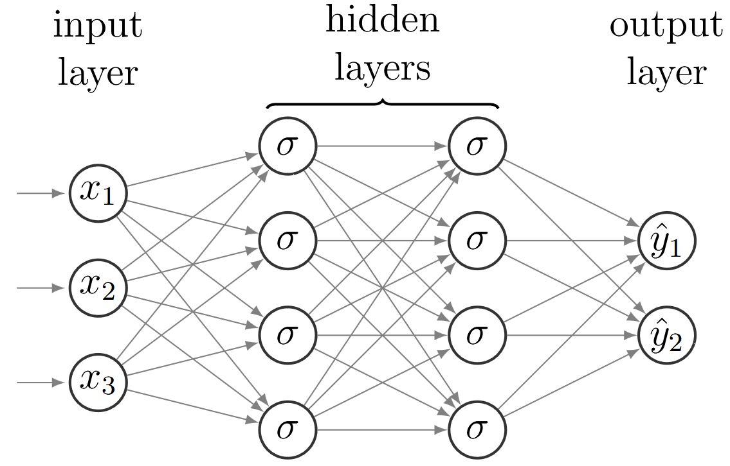
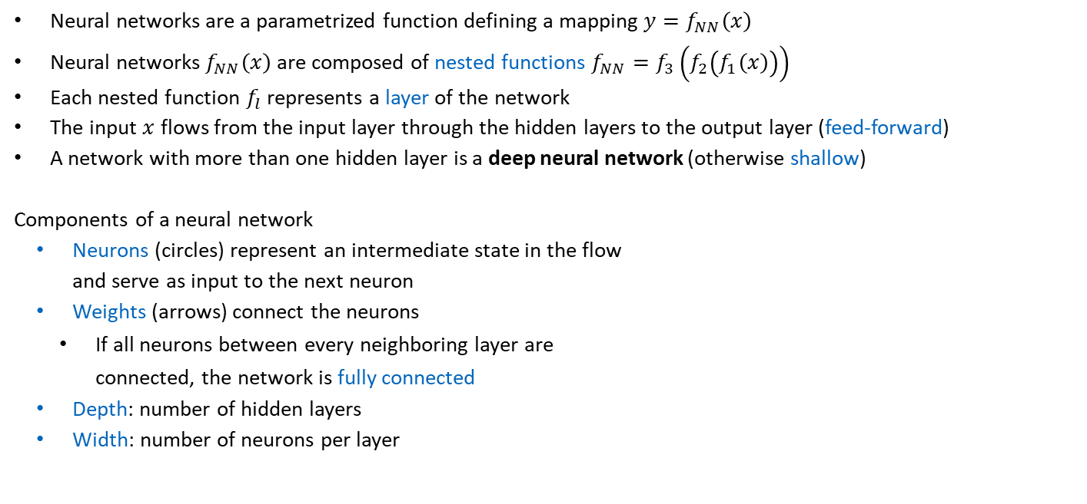
3.1 Fully Connected Neural Network
Neural networks are a parametrized function defining a mapping $y=f_{NN}\left(x\right)$
Neural networks $f_{NN}\left(x\right)$ are composed of nested functions $f_{NN}=f_{3}\left(f_{2}\left(f_{1}\left(x\right)\right)\right)$
Each nested function $f_{l}$ represents a layer of the network
The input $x$ flows from the input layer through the hidden layers to the output layer (feed-forward)
A network with more than one hidden layer is a deep neural network (otherwise shallow)
Components of a neural network
Neurons (circles) represent an intermediate state in the flow and serve as input to the next neuron
Weights (arrows) connect the neurons
If all neurons between every neighboring layer are connected, the network is fully connected
Depth: number of hidden layers
Width: number of neurons per layer
This is a fully connected feed-forward neural network. This is typically abbreviated as fully connected neural network.

Slide 4
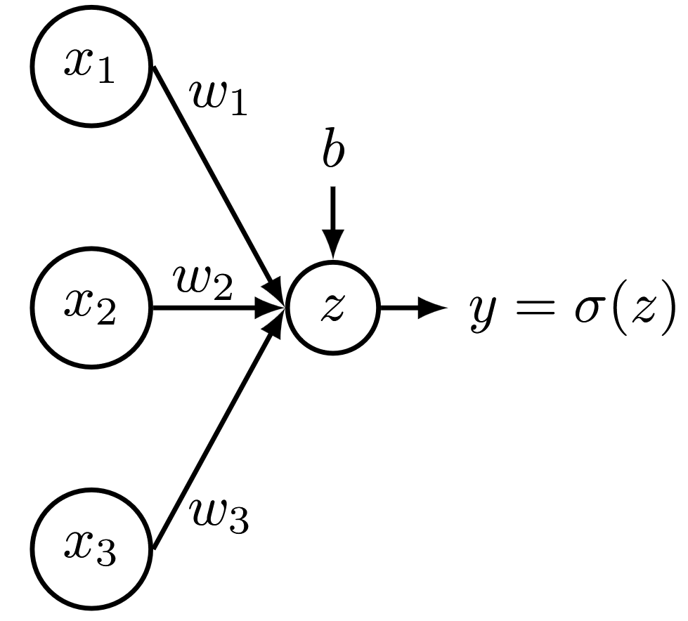
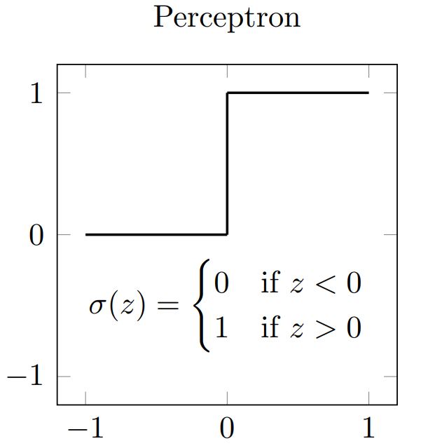
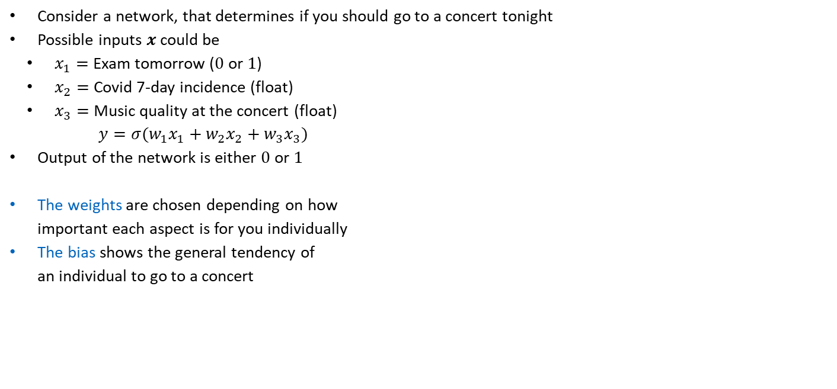
How do neural networks predict?
Consider a network, that determines if you should go to a concert tonight
Possible inputs $x$ could be
$x_{1}=$Exam tomorrow ($0$ or $1$)
$x_{2}=$ Covid 7-day incidence (float)
$x_{3}=$ Music quality at the concert (float)
$y=σ(w_{1}x_{1}+w_{2}x_{2}+w_{3}x_{3})$
Output of the network is either $0$or $1$
The weights are chosen depending on how important each aspect is for you individually
The bias shows the general tendency of an individual to go to a concert
A perceptron is an early architecture without hidden layers and a step function as activation function. Why is it problematic to train with modern techniques?

Slide 5
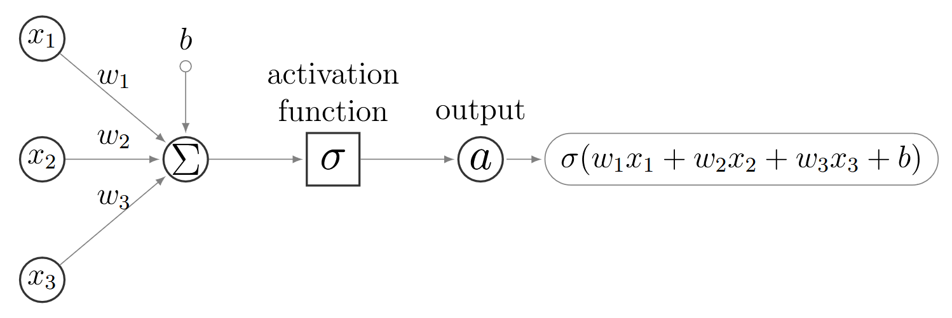
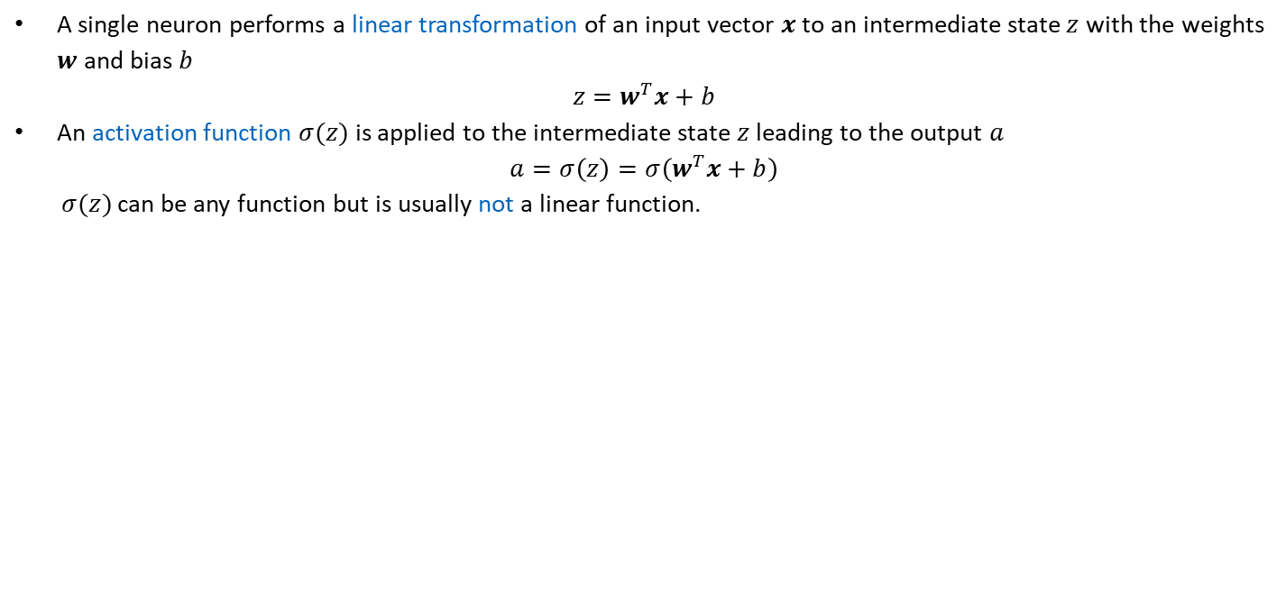
3.1 Fully Connected Neural Network
A single neuron performs a linear transformation of an input vector $x$ to an intermediate state $z$ with the weights $w$ and bias $b$
$$z=w^{T}x+b$$
An activation function $σ(z)$ is applied to the intermediate state $z$ leading to the output $a$
$$a=σ\left(z\right)=σ\left(w^{T}x+b\right)$$
$σ(z)$ can be any function but is usually not a linear function.

Slide 6
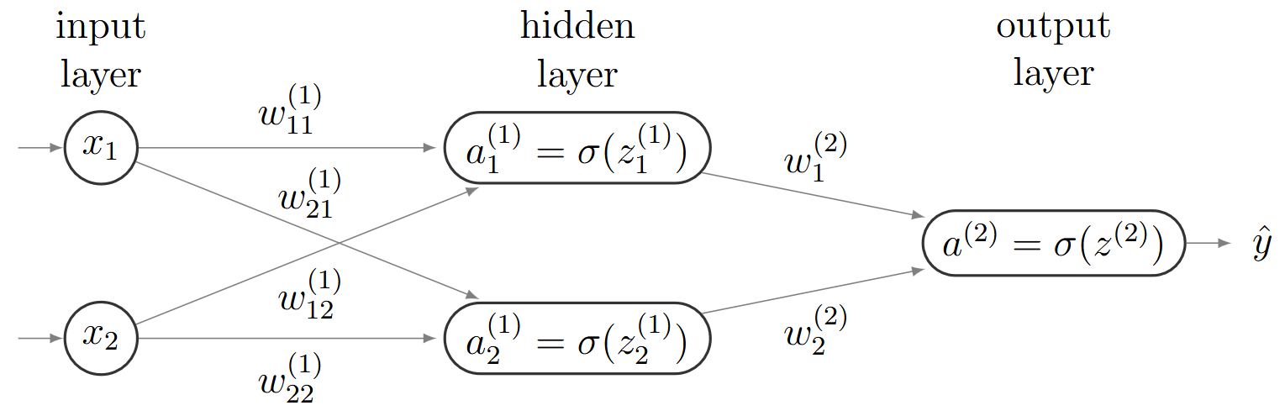
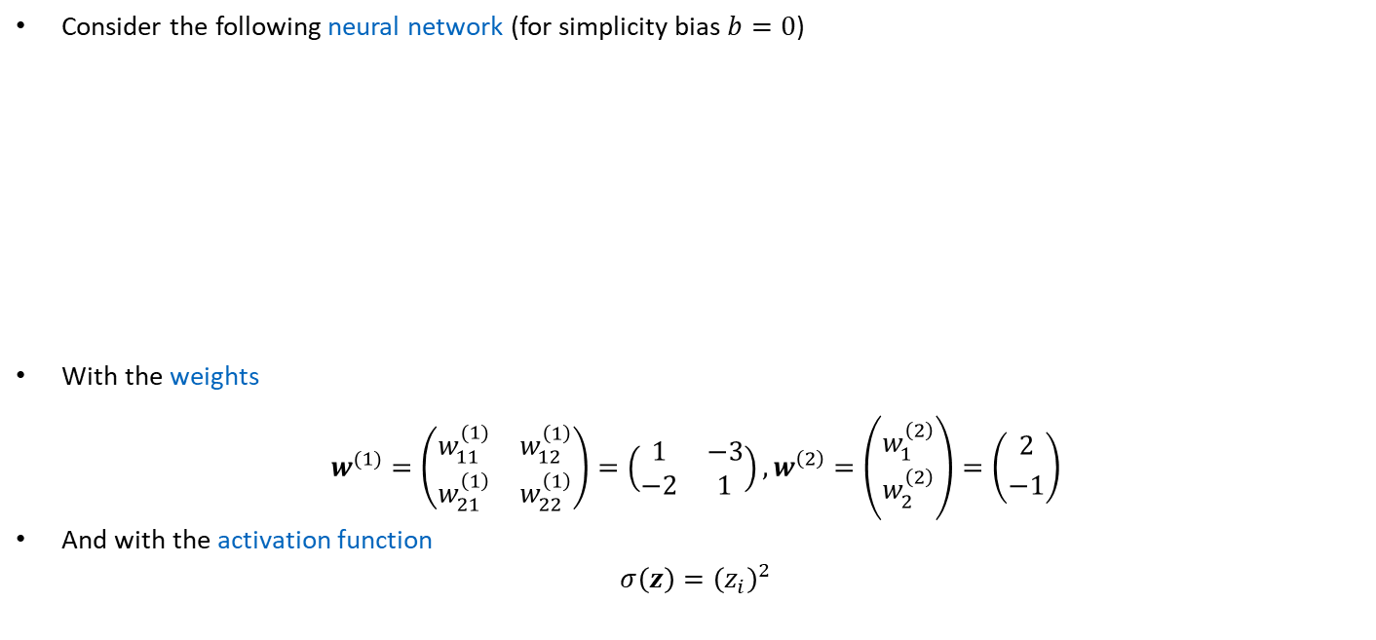
3.2 Forward Propagation – Example
Consider the following neural network (for simplicity bias $b=0$)
With the weights
$$w^{(1)}=\left(\begin{matrix}w_{11}^{(1)} & w_{12}^{\left(1\right)} \\ w_{21}^{\left(1\right)} & w_{22}^{\left(1\right)}\end{matrix}\right)=\left(\begin{matrix}1 & −3 \\ −2 & 1\end{matrix}\right), w^{\left(2\right)}=\left({w_{1}^{\left(2\right)} \atop w_{2}^{\left(2\right)}}\right)=\left({2 \atop −1}\right)$$
And with the activation function
$$σ\left(z\right)={\left(z_{i}\right)}^{2}$$

Slide 7
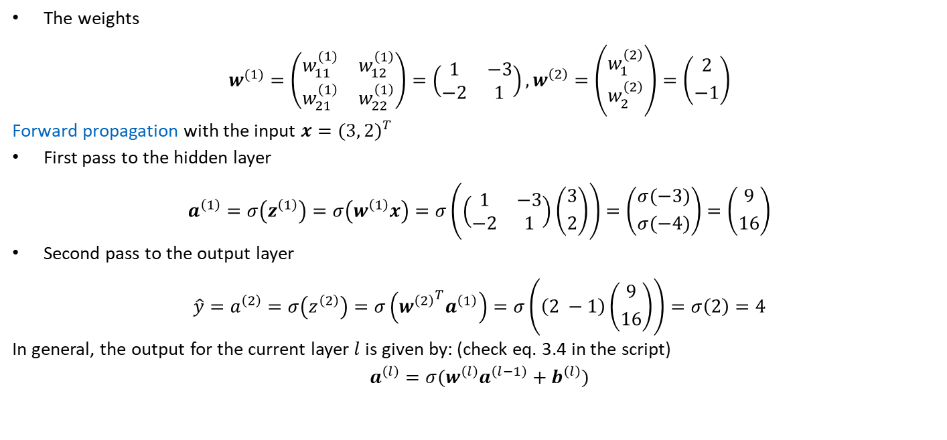
3.2 Forward Propagation – Example
The weights
$$w^{(1)}=\left(\begin{matrix}w_{11}^{(1)} & w_{12}^{\left(1\right)} \\ w_{21}^{\left(1\right)} & w_{22}^{\left(1\right)}\end{matrix}\right)=\left(\begin{matrix}1 & −3 \\ −2 & 1\end{matrix}\right), w^{\left(2\right)}=\left({w_{1}^{\left(2\right)} \atop w_{2}^{\left(2\right)}}\right)=\left({2 \atop −1}\right)$$
Forward propagation with the input $x={(3, 2)}^{T}$
First pass to the hidden layer
$$a^{\left(1\right)}=σ\left(z^{\left(1\right)}\right)=σ\left(w^{\left(1\right)}x\right)=σ\left(\left(\begin{matrix}1 & −3 \\ −2 & 1\end{matrix}\right)\left({3 \atop 2}\right)\right)=\left({σ(−3) \atop σ(−4)}\right)=\left({9 \atop 16}\right)$$
Second pass to the output layer
$$\hat{y}=a^{\left(2\right)}=σ\left(z^{\left(2\right)}\right)=σ\left({w^{\left(2\right)}}^{T}a^{\left(1\right)}\right)=σ\left(\left(2 −1\right)\left({9 \atop 16}\right)\right)=σ\left(2\right)=4$$
In general, the output for the current layer $l$ is given by: (check eq. 3.4 in the script)
$$a^{\left(l\right)}=σ(w^{\left(l\right)}a^{\left(l−1\right)}+b^{\left(l\right)})$$

Slide 8
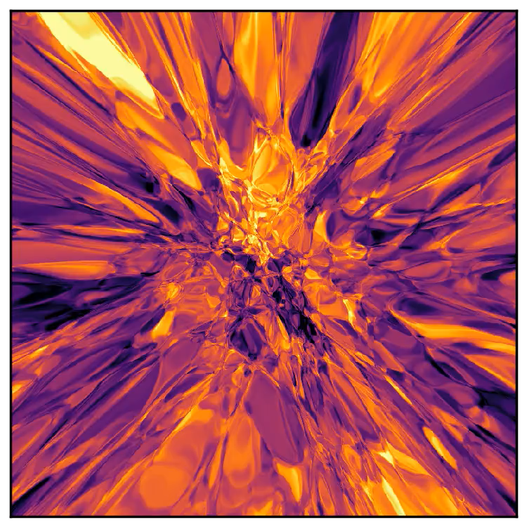
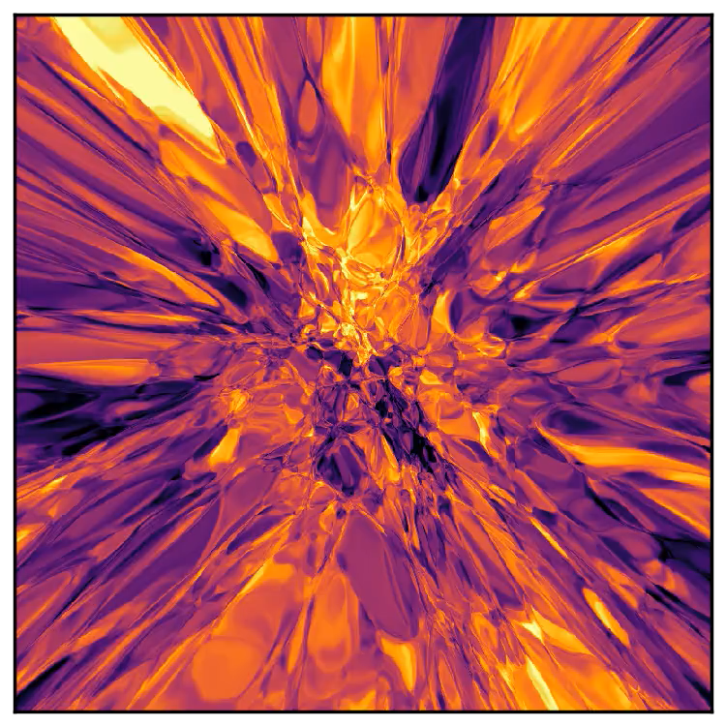

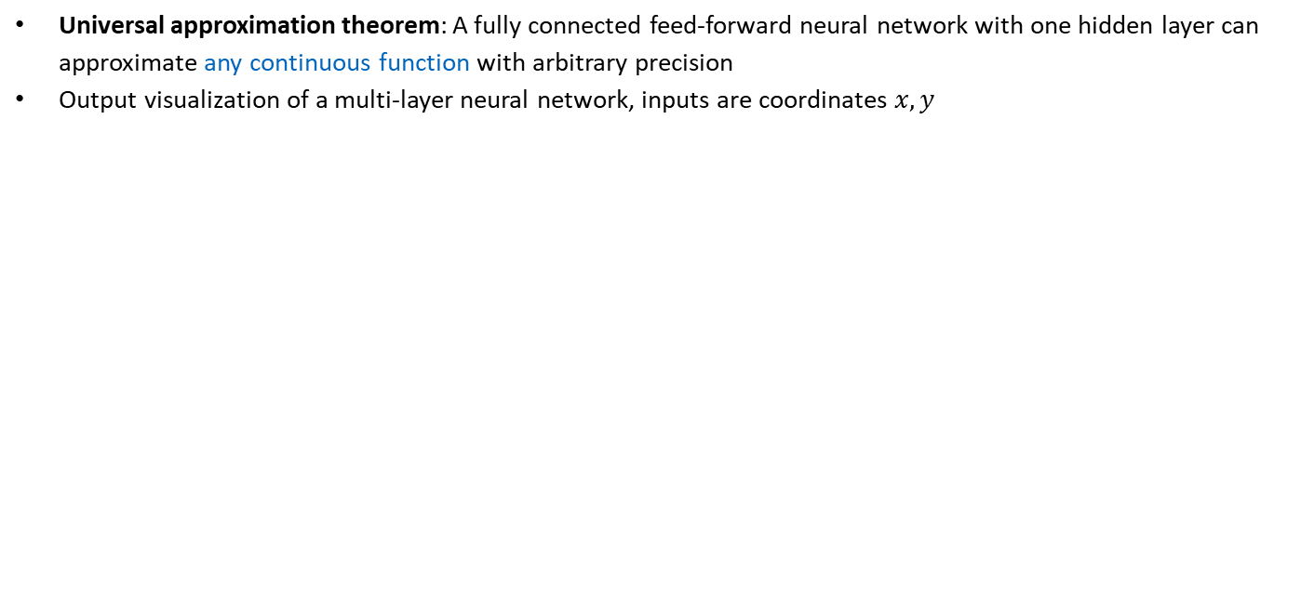
3.2 Forward Propagation
Universal approximation theorem: A fully connected feed-forward neural network with one hidden layer can approximate any continuous function with arbitrary precision
Output visualization of a multi-layer neural network, inputs are coordinates $x, y$

Slide 9
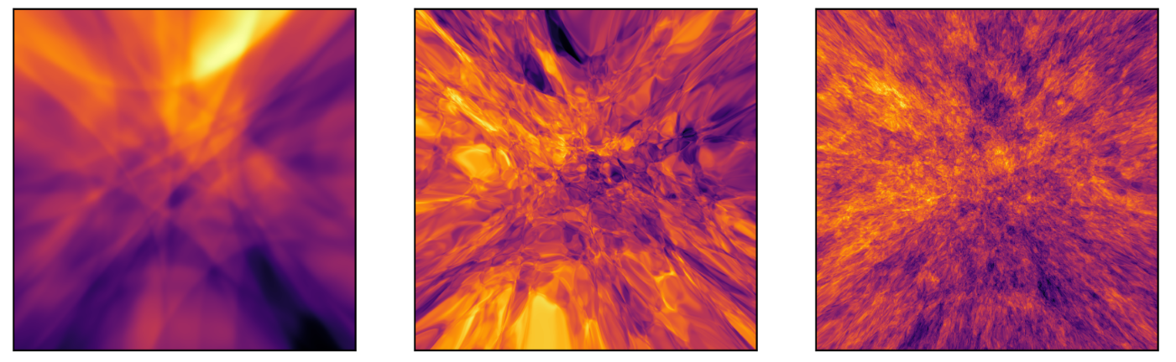
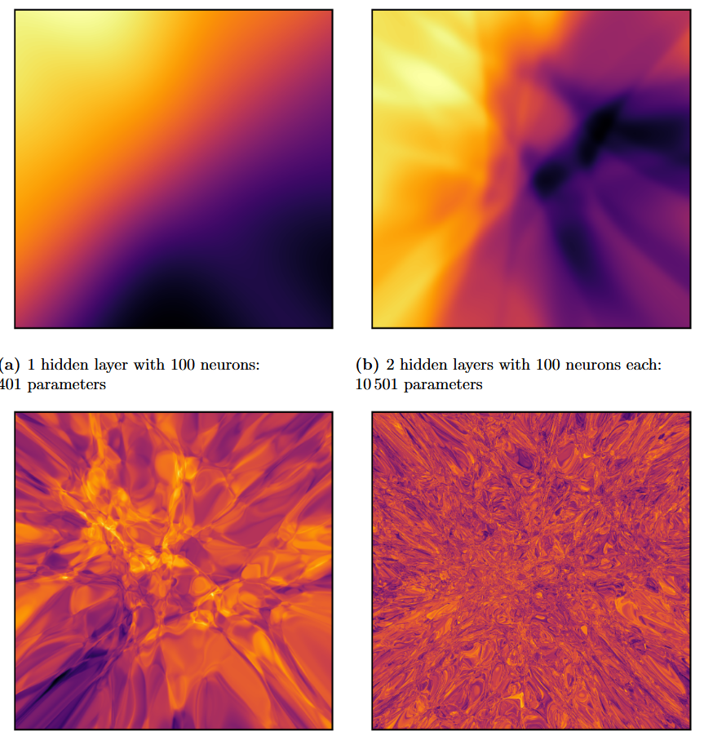
3.2 Forward Propagation
2 layers with 300 neurons: 91‘501 parameters
5 layers with 150 neurons: 91‘201 parameters
5 layers with 800 neurons: 2‘566‘401 parameters
Deeper neural networks are more favorable, as fewer parameters are required to achieve greater approximation power (more nested non-linearities)
2 layers with 100 neurons: 10‘501 parameters
5 layers with 100 neurons: 40‘801 parameters
10 layers with 100 neurons: 91‘301 parameters

Slide 10
Exercises
E.10 Neural Network Representational Capacity (C)
Experience the representational capacity of neural networks by experimenting with the neural network architecture.

Slide 11
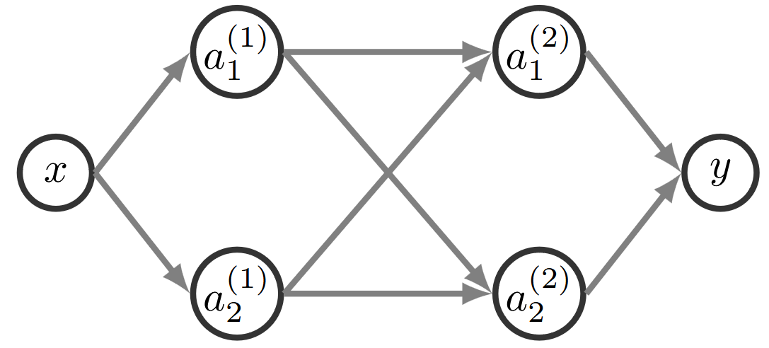
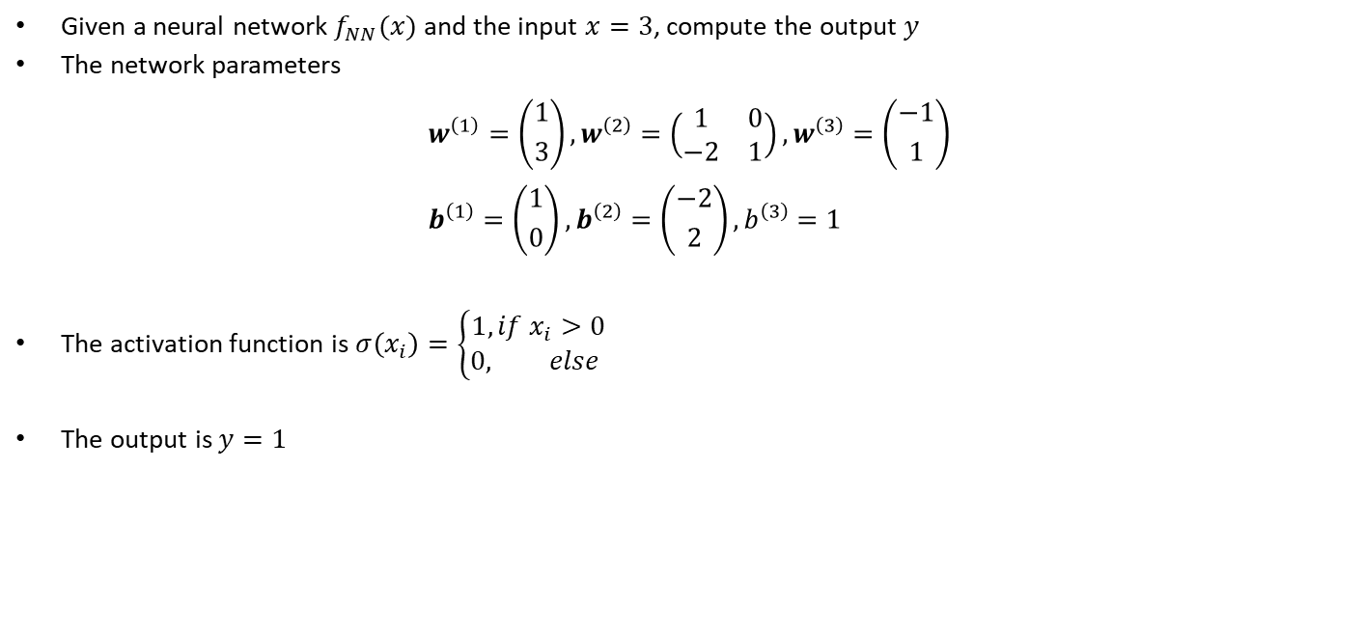
3.2 Forward Propagation – homework exercise
Given a neural network $f_{NN}(x)$ and the input $x=3$, compute the output $y$
The network parameters
$$w^{\left(1\right)}=\left({1 \atop 3}\right), w^{\left(2\right)}=\left(\begin{matrix}1 & 0 \\ −2 & 1\end{matrix}\right), w^{\left(3\right)}=\left({−1 \atop 1}\right) \\ b^{\left(1\right)}=\left({1 \atop 0}\right), b^{\left(2\right)}=\left({−2 \atop 2}\right), b^{\left(3\right)}=1$$
The activation function is $σ\left(x_{i}\right)=\left\{\begin{aligned}1, if x_{i}>0 \\ 0, else \end{aligned}\right.$
The output is $y=1$

Slide 12
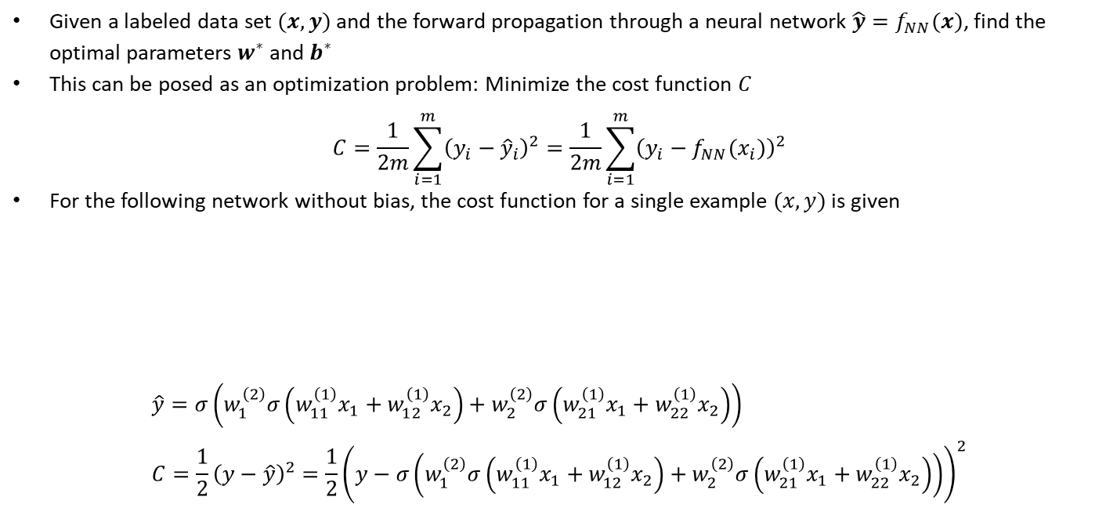
3.3 Differentiation
Given a labeled data set $(x, y)$ and the forward propagation through a neural network $\hat{y}=f_{NN}(x)$, find the optimal parameters $w^{∗}$ and $b^{∗}$
This can be posed as an optimization problem: Minimize the cost function $C$
$$C=\frac{1}{2m}\sum_{i=1}^{m}{{\left(y_{i}−{\hat{y}}_{i}\right)}^{2}}=\frac{1}{2m}\sum_{i=1}^{m}{{\left(y_{i}−{f_{NN}(x}_{i})\right)}^{2}}$$
For the following network without bias, the cost function for a single example $(x,y)$ is given
$$\hat{y}=σ\left(w_{1}^{\left(2\right)}σ\left(w_{11}^{\left(1\right)}x_{1}+w_{12}^{\left(1\right)}x_{2}\right)+w_{2}^{\left(2\right)}σ\left(w_{21}^{\left(1\right)}x_{1}+w_{22}^{\left(1\right)}x_{2}\right)\right) \\ C=\frac{1}{2}{\left(y−\hat{y}\right)}^{2}=\frac{1}{2}{\left(y−σ\left(w_{1}^{\left(2\right)}σ\left(w_{11}^{\left(1\right)}x_{1}+w_{12}^{\left(1\right)}x_{2}\right)+w_{2}^{\left(2\right)}σ\left(w_{21}^{\left(1\right)}x_{1}+w_{22}^{\left(1\right)}x_{2}\right)\right)\right)}^{2}$$

Slide 13
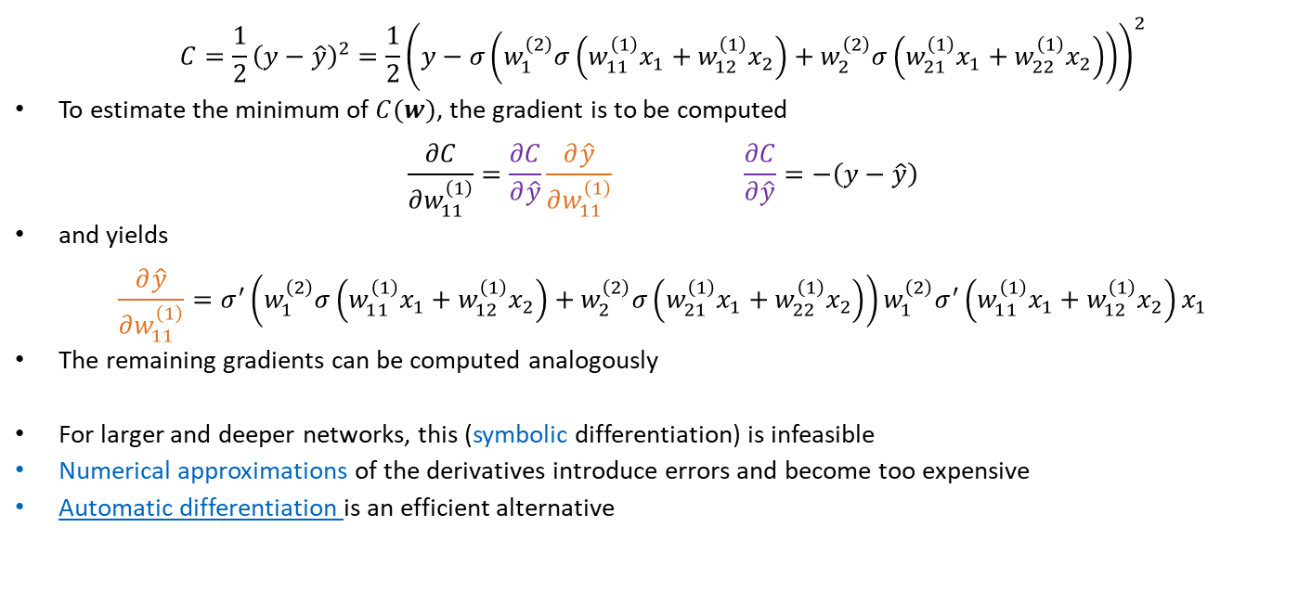
3.3 Differentiation
$$C=\frac{1}{2}{\left(y−\hat{y}\right)}^{2}=\frac{1}{2}{\left(y−σ\left(w_{1}^{\left(2\right)}σ\left(w_{11}^{\left(1\right)}x_{1}+w_{12}^{\left(1\right)}x_{2}\right)+w_{2}^{\left(2\right)}σ\left(w_{21}^{\left(1\right)}x_{1}+w_{22}^{\left(1\right)}x_{2}\right)\right)\right)}^{2}$$
To estimate the minimum of $C(w)$, the gradient is to be computed
$$\frac{∂C}{∂w_{11}^{\left(1\right)}}=\frac{∂C}{∂\hat{y}}\frac{∂\hat{y}}{∂w_{11}^{\left(1\right)}} \frac{∂C}{∂\hat{y}}=−\left(y−\hat{y}\right)$$
and yields
$$\frac{∂\hat{y}}{∂w_{11}^{\left(1\right)}}=σ^{′}\left(w_{1}^{\left(2\right)}σ\left(w_{11}^{\left(1\right)}x_{1}+w_{12}^{\left(1\right)}x_{2}\right)+w_{2}^{\left(2\right)}σ\left(w_{21}^{\left(1\right)}x_{1}+w_{22}^{\left(1\right)}x_{2}\right)\right)w_{1}^{\left(2\right)}σ^{′}\left(w_{11}^{\left(1\right)}x_{1}+w_{12}^{\left(1\right)}x_{2}\right)x_{1}$$
The remaining gradients can be computed analogously
For larger and deeper networks, this (symbolic differentiation) is infeasible
Numerical approximations of the derivatives introduce errors and become too expensive
Automatic differentiation is an efficient alternative

Slide 14
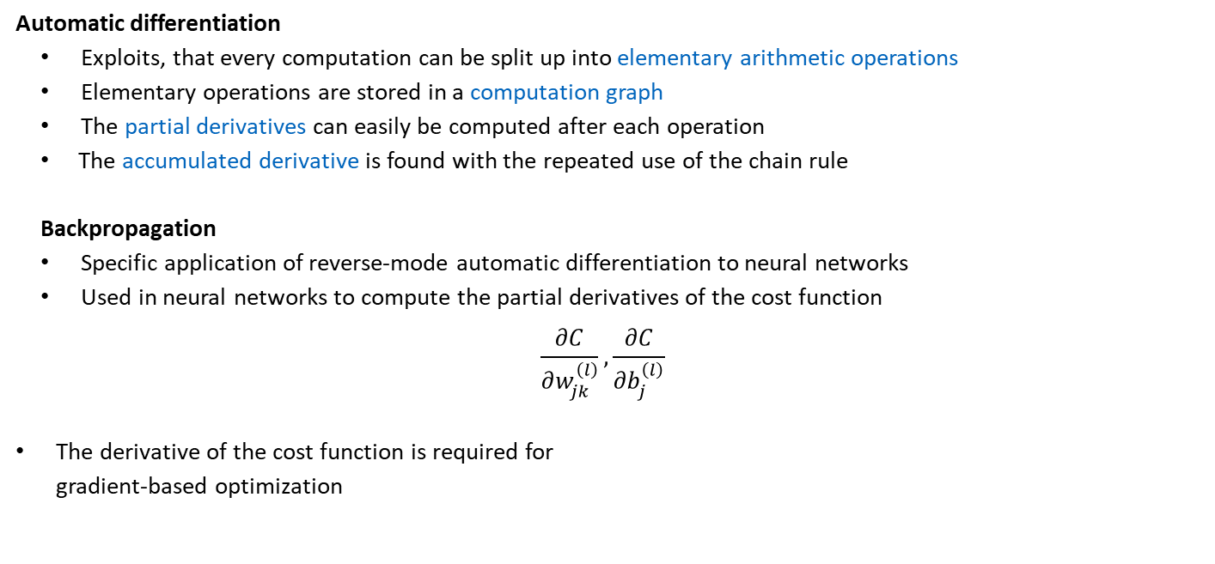
3.4 Backpropagation
Automatic differentiation
Exploits, that every computation can be split up into elementary arithmetic operations
Elementary operations are stored in a computation graph
The partial derivatives can easily be computed after each operation
The accumulated derivative is found with the repeated use of the chain rule
Backpropagation
Specific application of reverse-mode automatic differentiation to neural networks
Used in neural networks to compute the partial derivatives of the cost function
$$\frac{∂C}{∂w_{jk}^{\left(l\right)}},\frac{∂C}{∂b_{j}^{\left(l\right)}}$$
The derivative of the cost function is required for gradient-based optimization
Forward-mode automatic differentiation:
Good for deriving many outputs with respect to few inputs
Reverse-mode automatic differentiation:
Good for deriving few outputs with respect to many inputs
What is better for neural networks?

Slide 15
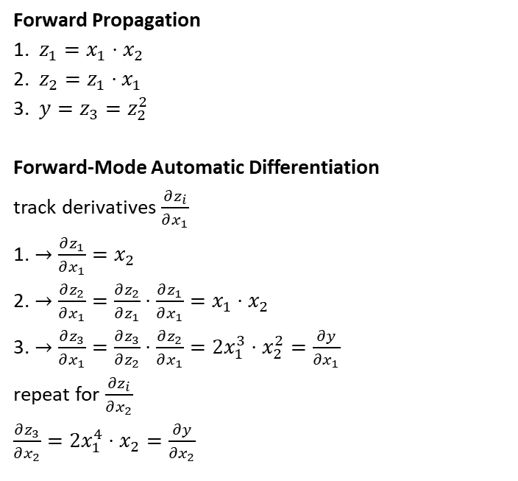
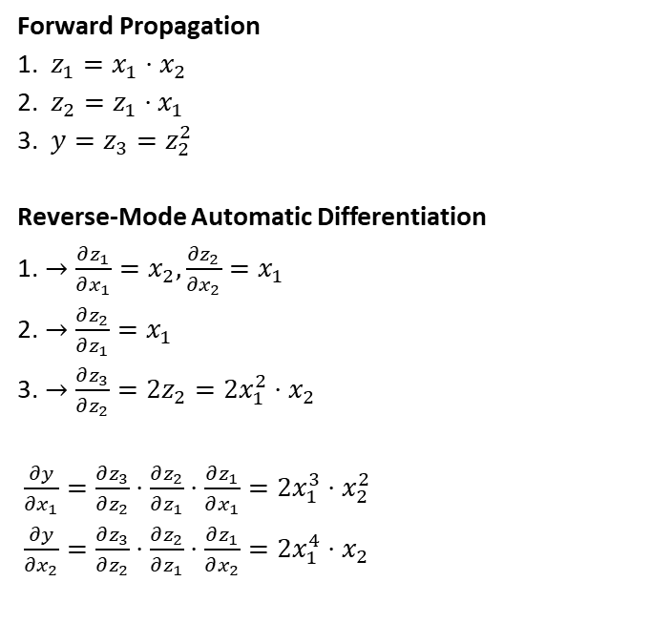
Forward- & Reverse-Mode Automatic Differentiation
Forward Propagation
1. $z_{1}=x_{1}⋅x_{2}$
2. $z_{2}=z_{1}⋅x_{1}$
3. ${y=z}_{3}=z_{2}^{2}$
Reverse-Mode Automatic Differentiation
1. $→\frac{∂z_{1}}{∂x_{1}}=x_{2},\frac{∂z_{2}}{∂x_{2}}=x_{1}$
2. $→\frac{∂z_{2}}{∂z_{1}}=x_{1}$
3. $→\frac{∂z_{3}}{∂z_{2}}=2z_{2}=2x_{1}^{2}⋅x_{2}$
$\frac{∂y}{{∂x}_{1}}=\frac{∂z_{3}}{∂z_{2}}⋅\frac{∂z_{2}}{∂z_{1}}⋅\frac{∂z_{1}}{∂x_{1}}=2x_{1}^{3}⋅x_{2}^{2}$
$\frac{∂y}{{∂x}_{2}}=\frac{∂z_{3}}{∂z_{2}}⋅\frac{∂z_{2}}{∂z_{1}}⋅\frac{∂z_{1}}{∂x_{2}}=2x_{1}^{4}⋅x_{2}$
Forward Propagation
1. $z_{1}=x_{1}⋅x_{2}$
2. $z_{2}=z_{1}⋅x_{1}$
3. ${y=z}_{3}=z_{2}^{2}$
Forward-Mode Automatic Differentiation
track derivatives $\frac{∂z_{i}}{∂x_{1}}$
1. $→\frac{∂z_{1}}{∂x_{1}}=x_{2}$
2. $→\frac{∂z_{2}}{∂x_{1}}=\frac{∂z_{2}}{∂z_{1}}⋅\frac{∂z_{1}}{∂x_{1}}=x_{1}⋅x_{2}$
3. $→\frac{∂z_{3}}{∂x_{1}}=\frac{∂z_{3}}{∂z_{2}}⋅\frac{∂z_{2}}{∂x_{1}}=2x_{1}^{3}⋅x_{2}^{2}=\frac{∂y}{∂x_{1}}$
repeat for $\frac{∂z_{i}}{∂x_{2}}$ $\frac{∂z_{3}}{∂x_{2}}=2x_{1}^{4}⋅x_{2}=\frac{∂y}{{∂x}_{2}}$

Slide 16
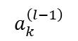
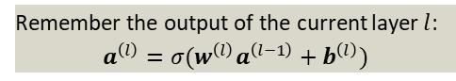
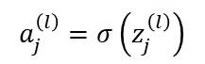
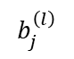
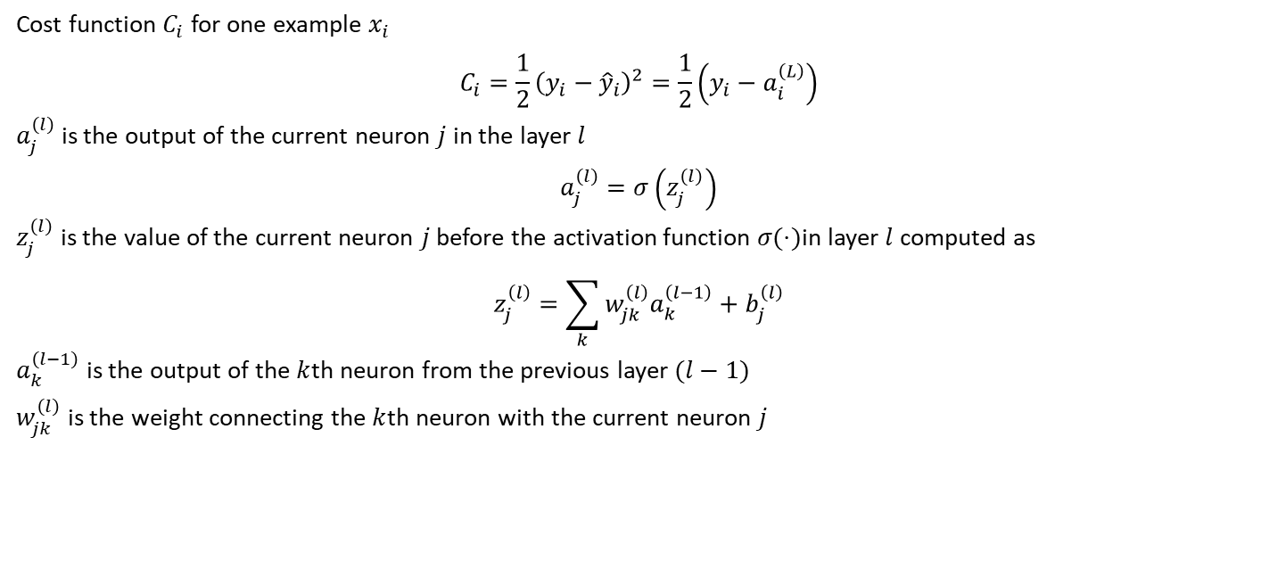
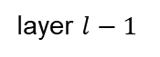
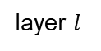
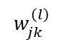
3.4 Backpropagation
Cost function $C_{i}$ for one example $x_{i}$
$$C_{i}=\frac{1}{2}{\left(y_{i}−{\hat{y}}_{i}\right)}^{2}=\frac{1}{2}\left(y_{i}−a_{i}^{\left(L\right)}\right)$$
$a_{j}^{\left(l\right)}$ is the output of the current neuron $j$ in the layer $l$
$$a_{j}^{\left(l\right)}=σ\left(z_{j}^{\left(l\right)}\right)$$
$z_{j}^{\left(l\right)}$ is the value of the current neuron $j$ before the activation function $σ(⋅)$in layer $l$ computed as
$$z_{j}^{\left(l\right)}=\sum_{k}^{ }{w_{jk}^{\left(l\right)}a_{k}^{\left(l−1\right)}+b_{j}^{\left(l\right)}}$$
$a_{k}^{\left(l−1\right)}$ is the output of the $k$th neuron from the previous layer $(l−1)$
$w_{jk}^{\left(l\right)}$ is the weight connecting the $k$th neuron with the current neuron $j$
Remember the output of the current layer $l$:
$$a^{\left(l\right)}=σ(w^{\left(l\right)}a^{\left(l−1\right)}+b^{\left(l\right)})$$
$$b_{j}^{\left(l\right)}$$
$$a_{j}^{\left(l\right)}=σ\left(z_{j}^{\left(l\right)}\right)$$
$$w_{jk}^{\left(l\right)}$$
$$a_{k}^{\left(l−1\right)}$$
layer $l−1$
layer $l$

Slide 17
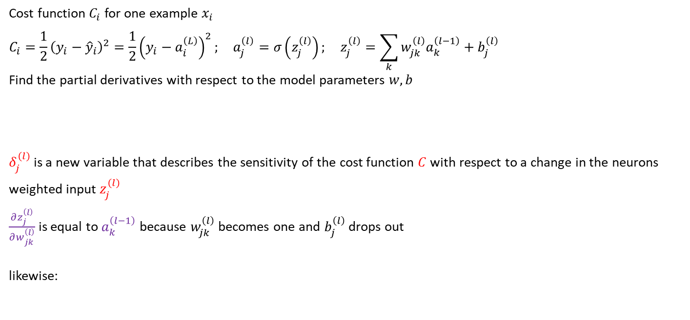
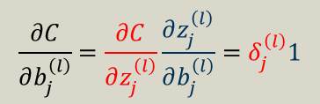
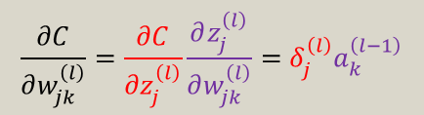
3.4 Backpropagation
Cost function $C_{i}$ for one example $x_{i}$
$$C_{i}=\frac{1}{2}{\left(y_{i}−{\hat{y}}_{i}\right)}^{2}=\frac{1}{2}{\left(y_{i}−a_{i}^{\left(L\right)}\right)}^{2}; a_{j}^{\left(l\right)}=σ\left(z_{j}^{\left(l\right)}\right); z_{j}^{\left(l\right)}=\sum_{k}^{ }{w_{jk}^{\left(l\right)}a_{k}^{\left(l−1\right)}+b_{j}^{\left(l\right)}}$$
Find the partial derivatives with respect to the model parameters $w, b$
$δ_{j}^{\left(l\right)}$ is a new variable that describes the sensitivity of the cost function $C$with respect to a change in the neurons weighted input $z_{j}^{\left(l\right)}$
$\frac{∂z_{j}^{\left(l\right)}}{∂w_{jk}^{\left(l\right)}}$ is equal to $a_{k}^{\left(l−1\right)}$ because $w_{jk}^{\left(l\right)}$ becomes one and $b_{j}^{\left(l\right)}$ drops out
likewise:
$$\frac{∂C}{∂w_{jk}^{\left(l\right)}}=\frac{∂C}{∂z_{j}^{\left(l\right)}}\frac{∂z_{j}^{\left(l\right)}}{∂w_{jk}^{\left(l\right)}}=δ_{j}^{\left(l\right)}a_{k}^{\left(l−1\right)}$$
$$b_{j}^{\left(l\right)}$$
$$a_{j}^{\left(l\right)}=σ\left(z_{j}^{\left(l\right)}\right)$$
$$w_{jk}^{\left(l\right)}$$
$$\frac{∂C}{∂b_{j}^{\left(l\right)}}=\frac{∂C}{∂z_{j}^{\left(l\right)}}\frac{∂z_{j}^{\left(l\right)}}{∂b_{j}^{\left(l\right)}}=δ_{j}^{\left(l\right)}1$$
$$a_{k}^{\left(l−1\right)}$$
layer $l−1$
layer $l$

Slide 18
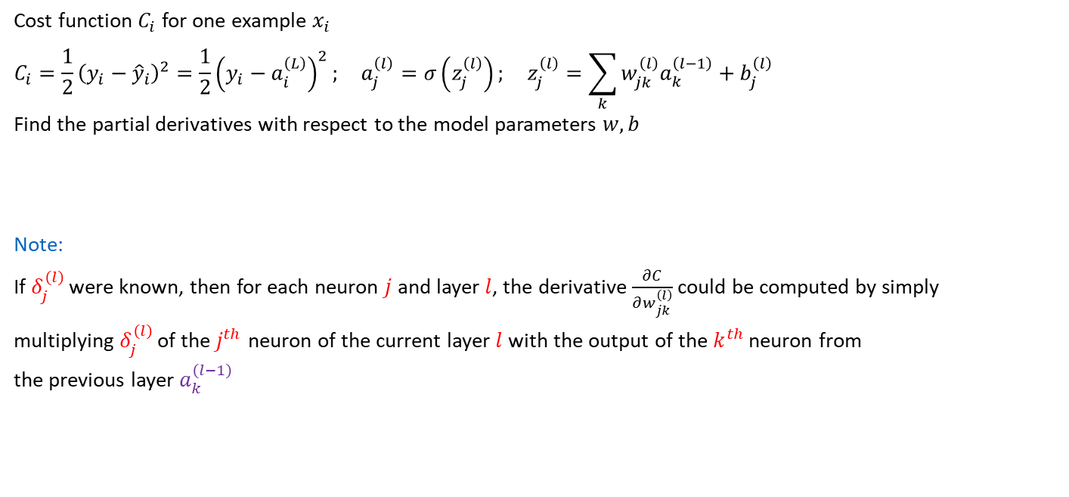
3.4 Backpropagation
Cost function $C_{i}$ for one example $x_{i}$
$$C_{i}=\frac{1}{2}{\left(y_{i}−{\hat{y}}_{i}\right)}^{2}=\frac{1}{2}{\left(y_{i}−a_{i}^{\left(L\right)}\right)}^{2}; a_{j}^{\left(l\right)}=σ\left(z_{j}^{\left(l\right)}\right); z_{j}^{\left(l\right)}=\sum_{k}^{ }{w_{jk}^{\left(l\right)}a_{k}^{\left(l−1\right)}+b_{j}^{\left(l\right)}}$$
Find the partial derivatives with respect to the model parameters $w, b$
Note:
If $δ_{j}^{\left(l\right)}$ were known, then for each neuron $j$ and layer $l$, the derivative $\frac{∂C}{∂w_{jk}^{\left(l\right)}}$ could be computed by simply multiplying $δ_{j}^{\left(l\right)}$ of the $j^{th}$ neuron of the current layer $l$with the output of the $k^{th}$ neuron from the previous layer $a_{k}^{\left(l−1\right)}$
$$\frac{∂C}{∂w_{jk}^{\left(l\right)}}=\frac{∂C}{∂z_{j}^{\left(l\right)}}\frac{∂z_{j}^{\left(l\right)}}{∂w_{jk}^{\left(l\right)}}=δ_{j}^{\left(l\right)}a_{k}^{\left(l−1\right)}$$
$$b_{j}^{\left(l\right)}$$
$$a_{j}^{\left(l\right)}=σ\left(z_{j}^{\left(l\right)}\right)$$
$$w_{jk}^{\left(l\right)}$$
$$a_{k}^{\left(l−1\right)}$$
layer $l−1$
layer $l$

Slide 19
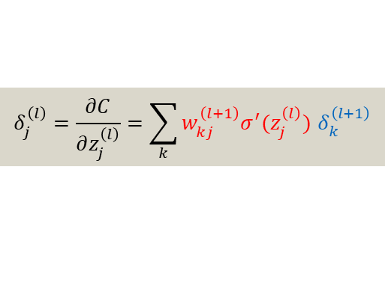
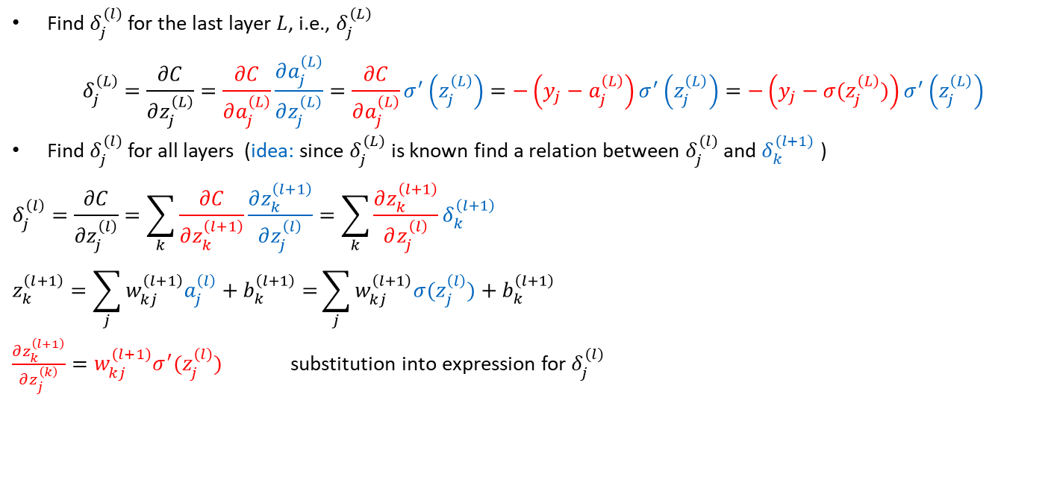
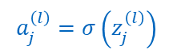
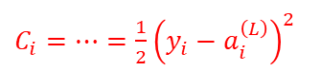
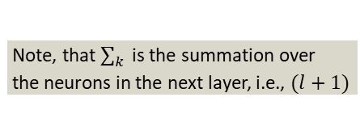
3.4 Backpropagation
$C_{i}=…=\frac{1}{2}{\left(y_{i}−a_{i}^{\left(L\right)}\right)}^{2}$
$$a_{j}^{\left(l\right)}=σ\left(z_{j}^{\left(l\right)}\right)$$
Find $δ_{j}^{\left(l\right)}$ for the last layer $L$, i.e., $δ_{j}^{\left(L\right)}$
$$δ_{j}^{\left(L\right)}=\frac{∂C}{∂z_{j}^{\left(L\right)}}=\frac{∂C}{∂a_{j}^{\left(L\right)}}\frac{∂a_{j}^{\left(L\right)}}{∂z_{j}^{\left(L\right)}}=\frac{∂C}{∂a_{j}^{\left(L\right)}}σ^{′}\left(z_{j}^{\left(L\right)}\right)=−\left(y_{j}−a_{j}^{\left(L\right)}\right)σ^{′}\left(z_{j}^{\left(L\right)}\right)=−\left(y_{j}−σ(z_{j}^{\left(L\right)})\right)σ^{′}\left(z_{j}^{\left(L\right)}\right)$$
Find $δ_{j}^{\left(l\right)}$ for all layers (idea: since $δ_{j}^{\left(L\right)}$ is known find a relation between $δ_{j}^{\left(l\right)}$ and $δ_{k}^{\left(l+1\right)}$ )
$$δ_{j}^{\left(l\right)}=\frac{∂C}{∂z_{j}^{\left(l\right)}}=\sum_{k}{\frac{∂C}{∂z_{k}^{\left(l+1\right)}}}\frac{∂z_{k}^{\left(l+1\right)}}{∂z_{j}^{\left(l\right)}}=\sum_{k}{\frac{∂z_{k}^{\left(l+1\right)}}{∂z_{j}^{\left(l\right)}}δ_{k}^{\left(l+1\right)}}$$
$$z_{k}^{\left(l+1\right)}=\sum_{j}{w_{kj}^{\left(l+1\right)}a_{j}^{\left(l\right)}+b_{k}^{\left(l+1\right)}=}\sum_{j}{w_{kj}^{\left(l+1\right)}{σ(z}_{j}^{\left(l\right)})+b_{k}^{\left(l+1\right)}}$$
$\frac{∂z_{k}^{\left(l+1\right)}}{∂z_{j}^{\left(k\right)}}=w_{kj}^{\left(l+1\right)}σ^{′}(z_{j}^{\left(l\right)})$ substitution into expression for $δ_{j}^{\left(l\right)}$
Note, that $\sum_{k}^{ }{ }$is the summation over
the neurons in the next layer, i.e., $(l+1)$
$$δ_{j}^{\left(l\right)}=\frac{∂C}{∂z_{j}^{\left(l\right)}}=\sum_{k}{w_{kj}^{\left(l+1\right)}σ^{′}(z_{j}^{\left(l\right)}) δ_{k}^{\left(l+1\right)}}$$

Slide 20
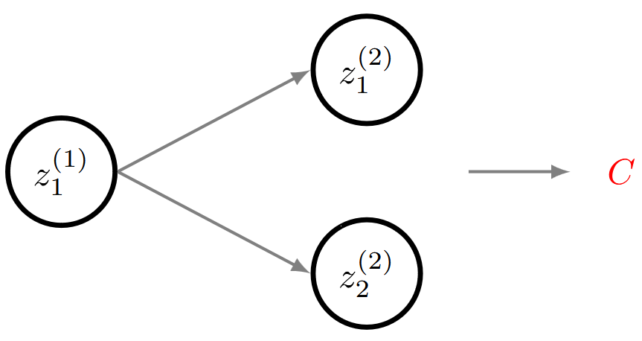
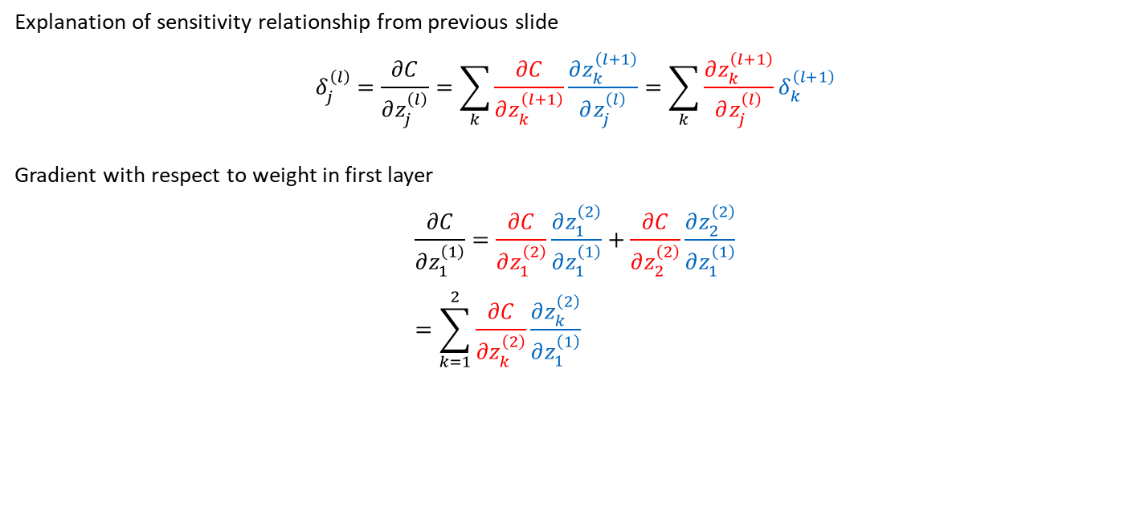
3.4 Backpropagation
Explanation of sensitivity relationship from previous slide
$$δ_{j}^{\left(l\right)}=\frac{∂C}{∂z_{j}^{\left(l\right)}}=\sum_{k}{\frac{∂C}{∂z_{k}^{\left(l+1\right)}}}\frac{∂z_{k}^{\left(l+1\right)}}{∂z_{j}^{\left(l\right)}}=\sum_{k}{\frac{∂z_{k}^{\left(l+1\right)}}{∂z_{j}^{\left(l\right)}}δ_{k}^{\left(l+1\right)}}$$
Gradient with respect to weight in first layer
$$\frac{∂C}{∂z_{1}^{\left(1\right)}}=\frac{∂C}{∂z_{1}^{\left(2\right)}}\frac{∂z_{1}^{\left(2\right)}}{∂z_{1}^{\left(1\right)}}+\frac{∂C}{∂z_{2}^{\left(2\right)}}\frac{∂z_{2}^{\left(2\right)}}{∂z_{1}^{\left(1\right)}} \\ =\sum_{k=1}^{2}{\frac{∂C}{∂z_{k}^{\left(2\right)}}}\frac{∂z_{k}^{\left(2\right)}}{∂z_{1}^{\left(1\right)}}$$

Slide 21
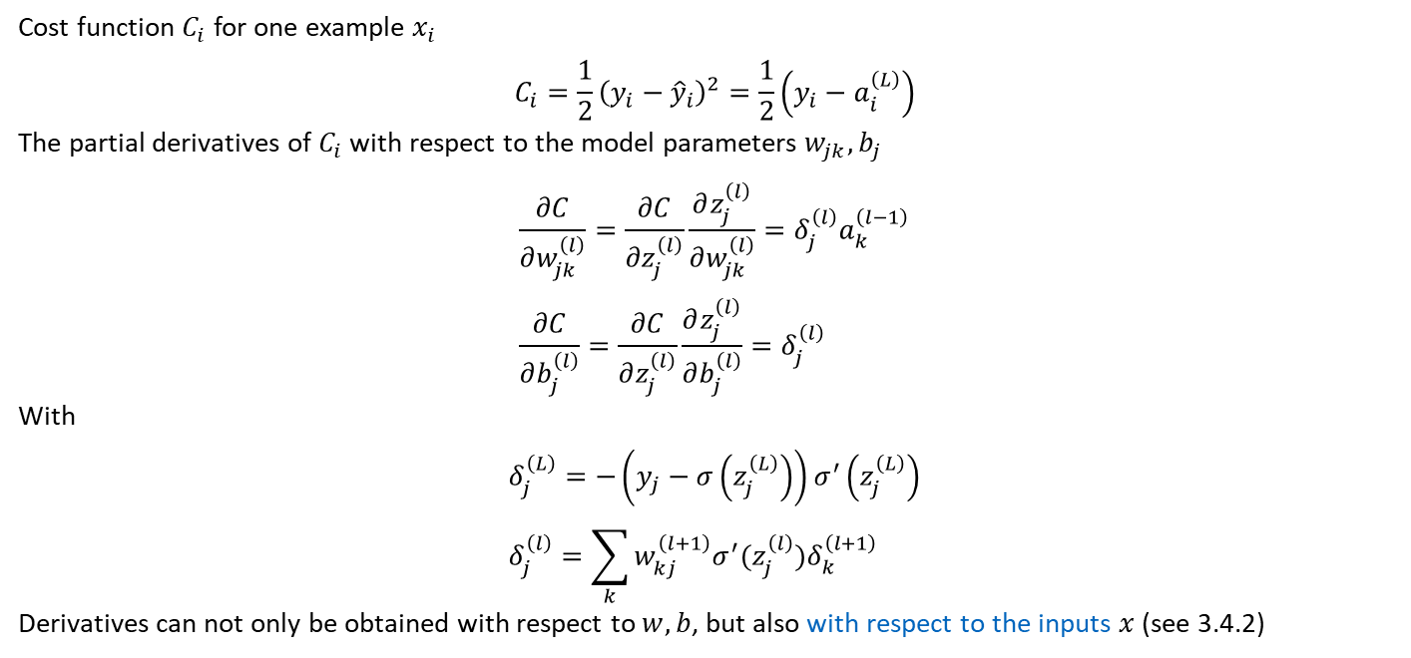
3.4 Backpropagation – Summary
Cost function $C_{i}$ for one example $x_{i}$
$$C_{i}=\frac{1}{2}{\left(y_{i}−{\hat{y}}_{i}\right)}^{2}=\frac{1}{2}\left(y_{i}−a_{i}^{\left(L\right)}\right)$$
The partial derivatives of $C_{i}$ with respect to the model parameters $w_{jk}, b_{j}$
$$\frac{∂C}{∂w_{jk}^{\left(l\right)}}=\frac{∂C}{∂z_{j}^{\left(l\right)}}\frac{∂z_{j}^{\left(l\right)}}{∂w_{jk}^{\left(l\right)}}=δ_{j}^{\left(l\right)}a_{k}^{\left(l−1\right)} \\ \frac{∂C}{∂b_{j}^{\left(l\right)}}=\frac{∂C}{∂z_{j}^{\left(l\right)}}\frac{∂z_{j}^{\left(l\right)}}{∂b_{j}^{\left(l\right)}}=δ_{j}^{\left(l\right)}$$
With
$$δ_{j}^{\left(L\right)}=−\left(y_{j}−σ\left(z_{j}^{\left(L\right)}\right)\right)σ^{′}\left(z_{j}^{\left(L\right)}\right) \\ δ_{j}^{\left(l\right)}=\sum_{k}{w_{kj}^{\left(l+1\right)}σ^{′}(z_{j}^{\left(l\right)})δ_{k}^{\left(l+1\right)}}$$
Derivatives can not only be obtained with respect to $w, b$, but also with respect to the inputs $x$ (see 3.4.2)
(Eq. 3.11)
(Eq. 3.14)
(Eq. 3.16)
(Eq. 3.18)
(Eq. 3.23)

Slide 22
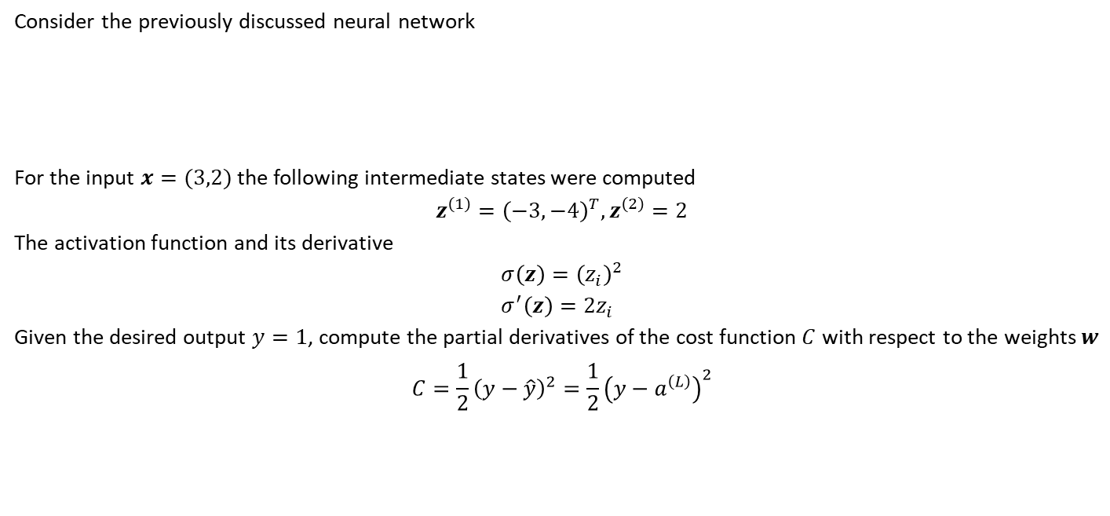
3.4 Backpropagation – Example
Consider the previously discussed neural network
For the input $x=(3,2)$ the following intermediate states were computed
$$z^{\left(1\right)}={\left(−3,−4\right)}^{T}, z^{\left(2\right)}=2$$
The activation function and its derivative
$$σ\left(z\right)={\left(z_{i}\right)}^{2} \\ σ^{′}\left(z\right)=2z_{i}$$
Given the desired output $y=1$, compute the partial derivatives of the cost function $C$ with respect to the weights $w$
$$C=\frac{1}{2}{\left(y−\hat{y}\right)}^{2}=\frac{1}{2}{\left(y−a^{\left(L\right)}\right)}^{2}$$

Slide 23
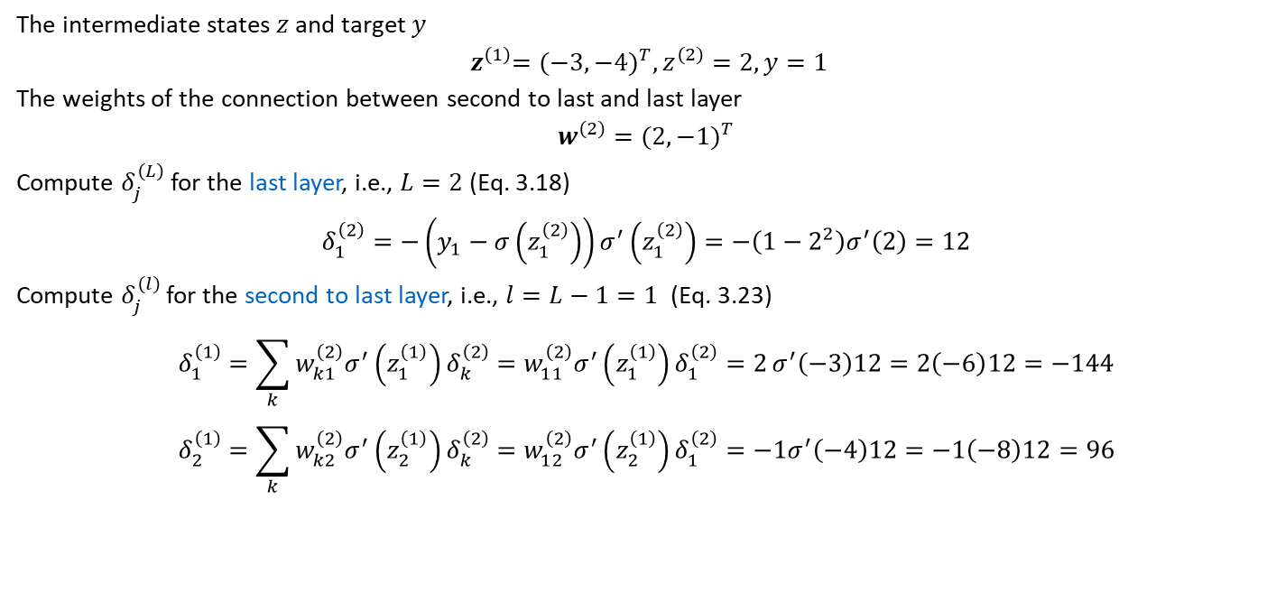
3.4 Backpropagation – Example
The intermediate states $z$and target $y$
$${ z}^{\left(1\right)}={(−3, −4)}^{T}, z^{\left(2\right)}=2, y=1$$
The weights of the connection between second to last and last layer
$$w^{\left(2\right)}={(2, −1)}^{T}$$
Compute $δ_{j}^{\left(L\right)}$ for the last layer, i.e., $L=2$ (Eq. 3.18)
$$δ_{1}^{\left(2\right)}=−\left(y_{1}−σ\left(z_{1}^{\left(2\right)}\right)\right)σ^{′}\left(z_{1}^{\left(2\right)}\right)=−\left(1−2^{2}\right)σ^{′}\left(2\right)=12$$
Compute $δ_{j}^{\left(l\right)}$ for the second to last layer, i.e., $l=L−1=1$ (Eq. 3.23)
$$δ_{1}^{\left(1\right)}=\sum_{k}{w_{k1}^{\left(2\right)}σ^{′}\left(z_{1}^{\left(1\right)}\right)δ_{k}^{\left(2\right)}=w_{11}^{\left(2\right)}σ^{′}\left(z_{1}^{\left(1\right)}\right)δ_{1}^{\left(2\right)}=2}σ^{′}\left(−3\right)12=2\left(−6\right)12=−144 \\ δ_{2}^{\left(1\right)}=\sum_{k}{w_{k2}^{\left(2\right)}σ^{′}\left(z_{2}^{\left(1\right)}\right)δ_{k}^{\left(2\right)}=w_{12}^{\left(2\right)}σ^{′}\left(z_{2}^{\left(1\right)}\right)δ_{1}^{\left(2\right)}=−1σ^{′}\left(−4\right)12}=−1\left(−8\right)12=96$$

Slide 24
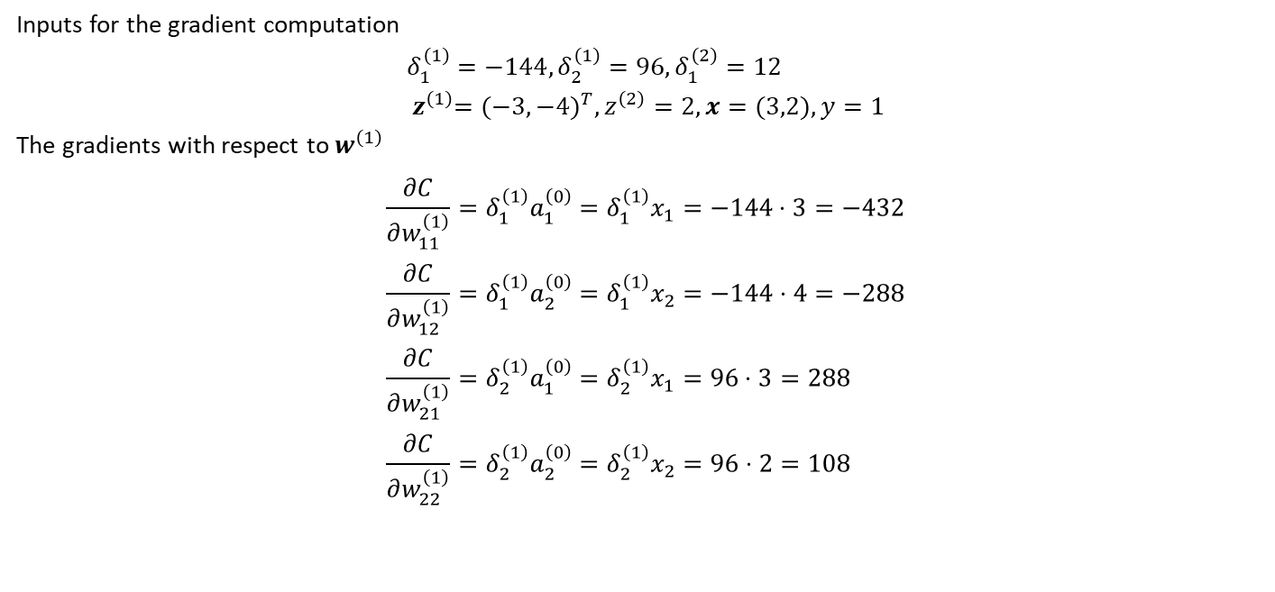
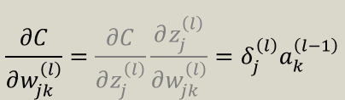
3.4 Backpropagation – Example
Inputs for the gradient computation
$$δ_{1}^{\left(1\right)}=−144, δ_{2}^{\left(1\right)}=96, δ_{1}^{\left(2\right)}=12 \\ { z}^{\left(1\right)}={(−3,−4)}^{T}, z^{\left(2\right)}=2,x=(3,2), y=1$$
The gradients with respect to $w^{\left(1\right)}$
$$\frac{∂C}{∂w_{11}^{\left(1\right)}}=δ_{1}^{\left(1\right)}a_{1}^{\left(0\right)}=δ_{1}^{\left(1\right)}x_{1}=−144⋅3=−432 \\ \frac{∂C}{∂w_{12}^{\left(1\right)}}=δ_{1}^{\left(1\right)}a_{2}^{\left(0\right)}=δ_{1}^{\left(1\right)}x_{2}=−144⋅4=−288 \\ \frac{∂C}{∂w_{21}^{\left(1\right)}}=δ_{2}^{\left(1\right)}a_{1}^{\left(0\right)}=δ_{2}^{\left(1\right)}x_{1}=96⋅3=288 \\ \frac{∂C}{∂w_{22}^{\left(1\right)}}=δ_{2}^{\left(1\right)}a_{2}^{\left(0\right)}=δ_{2}^{\left(1\right)}x_{2}=96⋅2=108$$
$$\frac{∂C}{∂w_{jk}^{\left(l\right)}}=\frac{∂C}{∂z_{j}^{\left(l\right)}}\frac{∂z_{j}^{\left(l\right)}}{∂w_{jk}^{\left(l\right)}}=δ_{j}^{\left(l\right)}a_{k}^{\left(l−1\right)}$$
(Eq. 3.14)

Slide 25
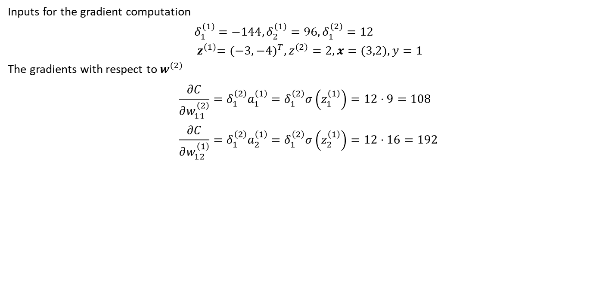
3.4 Backpropagation – Example
Inputs for the gradient computation
$$δ_{1}^{\left(1\right)}=−144, δ_{2}^{\left(1\right)}=96, δ_{1}^{\left(2\right)}=12 \\ { z}^{\left(1\right)}={(−3,−4)}^{T}, z^{\left(2\right)}=2,x=(3,2), y=1$$
The gradients with respect to $w^{\left(2\right)}$
$$\frac{∂C}{∂w_{11}^{\left(2\right)}}=δ_{1}^{\left(2\right)}a_{1}^{\left(1\right)}=δ_{1}^{\left(2\right)}σ\left(z_{1}^{\left(1\right)}\right)=12⋅9=108 \\ \frac{∂C}{∂w_{12}^{\left(1\right)}}=δ_{1}^{\left(2\right)}a_{2}^{\left(1\right)}=δ_{1}^{\left(2\right)}σ\left(z_{2}^{\left(1\right)}\right)=12⋅16=192$$
$$\frac{∂C}{∂w_{jk}^{\left(l\right)}}=\frac{∂C}{∂z_{j}^{\left(l\right)}}\frac{∂z_{j}^{\left(l\right)}}{∂w_{jk}^{\left(l\right)}}=δ_{j}^{\left(l\right)}a_{k}^{\left(l−1\right)}$$
(Eq. 3.14)

Slide 26
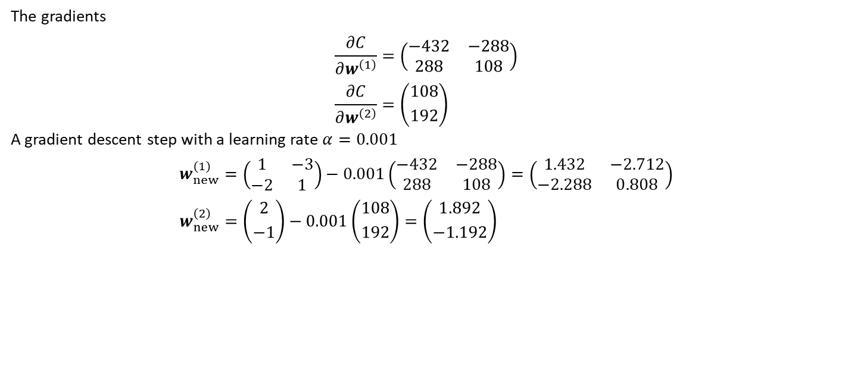
3.4 Backpropagation – Example
The gradients
$$\frac{∂C}{∂w^{\left(1\right)}}=\left(\begin{matrix}−432 & −288 \\ 288 & 108\end{matrix}\right) \\ \frac{∂C}{∂w^{\left(2\right)}}=\left({108 \atop 192}\right)$$
A gradient descent step with a learning rate $α=0.001$
$$w_{new}^{\left(1\right)}=\left(\begin{matrix}1 & −3 \\ −2 & 1\end{matrix}\right)−0.001\left(\begin{matrix}−432 & −288 \\ 288 & 108\end{matrix}\right)=\left(\begin{matrix}1.432 & −2.712 \\ −2.288 & 0.808\end{matrix}\right) \\ w_{new}^{\left(2\right)}=\left({2 \atop −1}\right)−0.001\left({108 \atop 192}\right)=\left({1.892 \atop −1.192}\right)$$
$$\frac{∂C}{∂w_{jk}^{\left(l\right)}}=\frac{∂C}{∂z_{j}^{\left(l\right)}}\frac{∂z_{j}^{\left(l\right)}}{∂w_{jk}^{\left(l\right)}}=δ_{j}^{\left(l\right)}a_{k}^{\left(l−1\right)}$$

Slide 27
Exercises
E.8 Neural Network Derivatives (P)
Manually compute the derivatives of a neural network using the derived backpropagation rules.
E.9 Neural Network from Scratch (C)
Using the forward propagation rules and the corresponding backpropagation rules, create a fully connected neural network in Python using only NumPy.

Slide 28
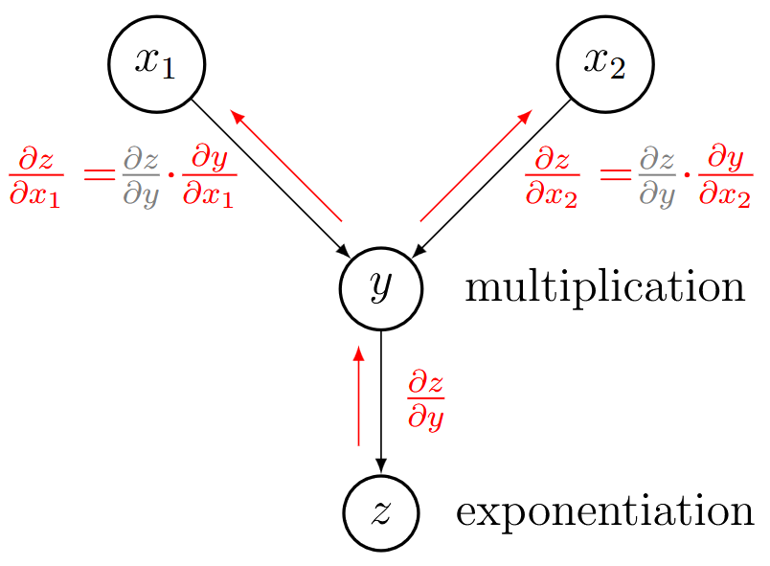
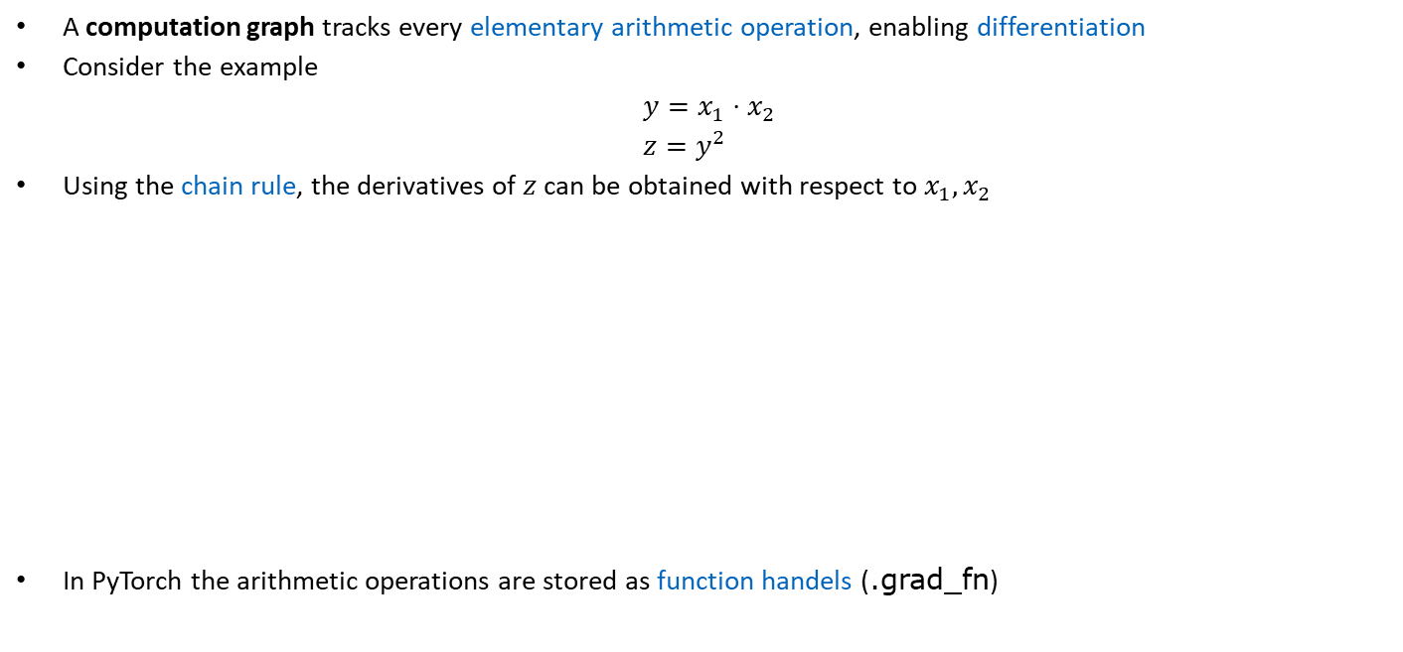
3.4.3 Generalization with Computation Graphs
A computation graph tracks every elementary arithmetic operation, enabling differentiation
Consider the example
$$y=x_{1}⋅x_{2} \\ z=y^{2}$$
Using the chain rule, the derivatives of $z$ can be obtained with respect to $x_{1},x_{2}$
In PyTorch the arithmetic operations are stored as function handels (.grad_fn)

Slide 29


3.4.3 Generalization with Computation Graphs
An general algorithm can be formulated by considering an aribtrary node $c$ connected to nodes $a, b, d, e$
$a, b$ are incoming
$d, e$ are outgoing
Gradient with respect to$c$
$$\frac{∂C}{∂c}=\frac{∂C}{∂c_{d}}+\frac{∂C}{∂c_{e}}$$
Where
$$\frac{∂C}{∂c_{d}}=\frac{∂C}{∂d}⋅\frac{∂d}{∂c_{d}}; \frac{∂C}{∂c_{e}}=\frac{∂C}{∂e}⋅\frac{∂e}{∂c_{e}}$$
(Back)propagation to incoming nodes
$$\frac{∂C}{∂a_{c}}=\frac{∂C}{∂c}⋅\frac{∂c}{∂a_{c}}; \frac{∂C}{∂b_{c}}=\frac{∂C}{∂c}⋅\frac{∂c}{∂b_{c}}$$
Which might be mixed with other gradient contributions to nodes $a, b$

Slide 30

3.5 Activation Functions
Common activation functions
Earliest choice
For binary classification
Positive output
Derivatives zero except at zero
Avoided
Final layer classification
Fast saturation
Positive output
Alternative: Softmax
Avoided
Final layer classification
Fast saturation
Zero-centered
Alternative: Softmax
Default choice
Learning can slow down if always zero
Alternative: Leaky ReLU, PReLU
Smooth: SiLU, ELU, SELU, GELU
See 3.5

Slide 31

3.6 Learning Algorithm
Prerequisites to train a neural network for a supervised learning task
Input data $\tilde{X}$ and corresponding targets $\tilde{y}$, divided into a training, validation and test set
Network topology (more in chapter 3.9)
Network initialization (not covered in this lecture, see, e.g., https://www.deeplearning.ai/ai-notes/initialization/)
Activation function $σ$
Cost function $C$ defining the prediction quality
Method of computing gradients with respect to the network parameters, e.g., backpropagation
Optimizer with hyperparameters, such as the learning rate $α$
Learning algorithms: 3 most common variants of one and the same idea: gradient-based optimization (as seen in Chapter 2)
full batch
stochastic
mini batch

Slide 32


3.6 Learning Algorithm – Full-batch
Accurate gradients at a high cost

Slide 33


3.6 Learning Algorithm – Stochastic
Cheap & innacurate approximation of gradients (enabling escape of local optima)

Slide 34


3.6 Learning Algorithm – Mini-batch
Improved approximation of the gradients at low computational cost

Slide 35


3.7 Regularization of Neural Networks
Noise: a Flaw in Human Judgement, Kahneman et al. 2021
Aim is to bring testing and training error closer together (without significantly increasing training error)
Trade reduction of variance for a slightly increased bias
Common approaches to reduce the variance
Constraints on model parameters (regularization)
Simpler models for better generalization
In deep learning, we typically use larger models with appropriate regularization mechanisms

Slide 36

3.7.1 Early Stopping
After a number of iterations (A), the training error continues to decrease, while the validation error increases
Point A can be identified by monitoring the validation error during training
Early stopping algorithm
Monitor validation error
If no improvement is made for a predefined number of iteration steps (B), the optimization is terminated
The model parameters at the lowest point (A) are retrieved
(Additional cost through continuous evaluation of the validation set)

Slide 37


3.7.2 $L^{1}$ and $L^{2}$ Regularization
Aim is to limit the capacity of the model by penalizing (large) model parameters $Θ$
Similar behavior as seen for linear regression in Chapter 2
In general with the penalty weight $λ$
$$\tilde{C}=C+λΩ$$
$L^{1}$ regularization
$$\tilde{C}=C+λ{\left|\left|w\right|\right|}_{1}$$
$L^{2}$ regularization
$$\tilde{C}=C+\frac{λ}{2}w⋅w$$
All of the above only act on the weights. What about the bias?
Regularization of the bias can lead to severe underfitting and typically requires less data to fit accurately

Slide 38



3.7.2 $L^{1}$ and $L^{2}$ Regularization
$L^{1}$ regularization
$$\tilde{C}=C(w)+λ{\left\|w\right\|}_{1} \\ \frac{∂\tilde{C}}{∂w}=\frac{∂C}{∂w}+λsign\left(w\right) \\ w→w^{′}=w−αλsign(w)−α\frac{∂C}{∂w}$$
Shrinks the absolute value of the weights by a constant, independent of the magnitude of the weight, i.e., only connections with large sensitivities $∂C/∂w$ survive: leads to a sparse model
$L^{2}$ regularization
$$\tilde{C}=C(w)+\frac{λ}{2}w^{T}w \\ \frac{∂\tilde{C}}{∂w}=\frac{∂C}{∂w}+λw \\ w→w^{′}=w−αλw−α\frac{∂C}{∂w}=w\left(1−αλ\right)−α\frac{∂C}{∂w}$$
Shrinks the weights proportional to the weights, i.e., small weights survive
sign extracts the sign of $w$
Only the sign of $w$ survives

Slide 39
3.7.3 Ensemble and Bagging Methods
Improve prediction quality by training multiple models and combining their outputs
Decrease variance & increase robustness (accuracy): wisdom of the crowd
Combination via voting or averaging scheme
Ensemble methods consider different models (e.g., different neural network architectures or even different machine learning methods)
Bagging methods consider the same model (i.e., the same neural network architecture), that has undergone multiple trainings

Slide 40


3.7.4 Dropout
Part of the neural connections is removed (dropped) for each gradient update
Input and output neurons remain untouched
A hyperparameter $p∈[0,1]$ controls the percentage of the network to be dropped
For the prediction, the entire network is used
Avoids any connection becoming too important (as connections are not reliable)
A feature has to be learned by multiple connections
In essence dropout is a bagging method trained at once (multiple different instances of the same network)
Assuming that “all networks“ overfit in a different way, dropout regulates overfitting
Dropout as a Bayesian Approximation: Representing Model Uncertainty in Deep Learning, Gal et al. 2015
In Monte Carlo Dropout, dropout is also used in the prediction stage, enabling multiple predictions to quantify uncertainties

Slide 41

3.7.5 Dataset Augmentation
Generalization capabilities are best improved by training on more data
Data acquisition is not always feasible
Generation of “fake“ data by augmenting available data
Example in image classification, which should be invariant to a wide range of transformations
Translation
Rotation
Flipping
Cropping
Noise
Contrast/Brightness

Slide 42
Contents
2 Fundamental Concepts of Machine Learning
3.1 Fully Connected Neural Network
3.2 Forward Propagation
3.3 Differentiation
3.4 Backpropagation
3.5 Activation Function
3.6 Learning Algorithm
3.7 Regularization of Neural Networks
3.8 Approximating the Sine Function
3.9.1 Convolutional Neural Networks
3.9.2 Graph Neural Networks
3.9.6 Recurrent Neural Networks
3.9.8 Physics-Inspired Architectures for Dynamics (Hamiltonian & Lagrangian Neural Networks)

Slide 43
3 Neural Networks: Fundamentals
Leon Herrmann
Stefan Kollmannsberger
Chair of Data Engineering in Construction
Bauhaus-Universität Weimar
Deep Learning in Computational Mechanics – an introductory course, Herrmann et al. 2025
website
book
Notes:
generated with https://www.the-qrcode-generator.com/

